Slide 1
Radiology Protocol Tool & Reporter (RAPTOR) Milestone #3 Review
SAN Business Consultants
June 23, 2014

Slide 2
Milestone #3 Agenda
Overview – Project Definition and Approach
Milestone #1 review completed
Milestone #2 review completed
Changes in the Innovations Sandbox
Series of SME meetings
User Acceptance Testing prep
Risk Log
Questions & Demo

Slide 3
Project Definition
Improve the safety, quality and efficiency of the protocol and ordering workflow
Evolve the prototype into the RAPTOR application in 18 months
Visual Design & Theme
Technical Implementation
Testing and Launch

Slide 4
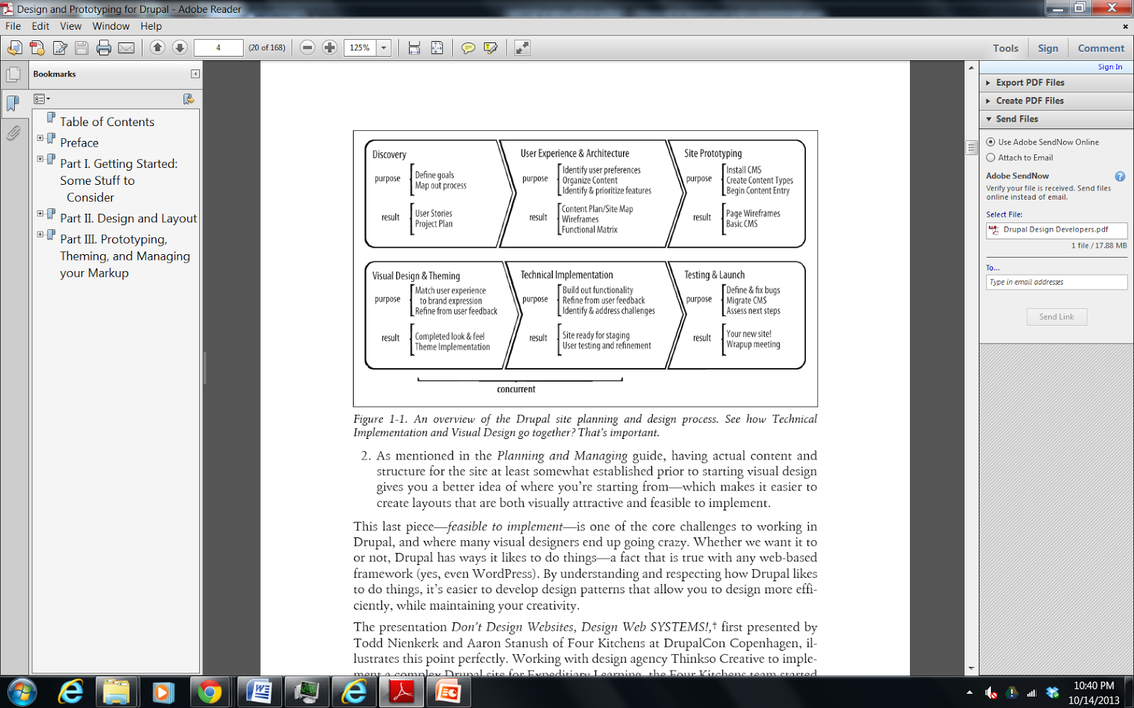
Approach of project
From Designing and Prototyping in Drupal, D. Nordin, 2012

Slide 5
SME meetings
We have held a series of functional meetings:
Requirements gathering
Understanding workflow & user experience
Functional demonstration
UAT preparation
Enhancement review

Slide 6
Milestone #1: Dec 23,2013
Increment #1 submitted on time included:
Style Sheets and theme images of new worklist and prototype screens
Contraindication Engine Architecture
Worklist Item Ranking
Worklist Processing Modes
Site Map
UI Guide
Ranking Algorithm
PM Plan, v.1.2

Slide 7
Innovations Sandbox
Virtual Testing Environment
SAN created and populated advanced imaging test data and installed the data loader into the sandbox
Migrated from cloud1 (VMware view client) to cloud2 (Amazon) last release
Installed VIX and Imaging Database
36 tickets total

Slide 8
Milestone #2: March 23,2014
Increment #2 submitted on time included:
RAPTOR in cloud2 pulling data from CPRS
UAT Plan
UAT Cases
Updated Technical Documents
Demonstration of 18 enhancements including:
Worklist management (dynamic sorting, hiding columns, minimize scrolling)
Dashboard (pre-populate protocol template, suspend/reserve functionality)

Slide 9
Scheduled Milestones
December 2013 – Theme and Worklist
March 2014 – Templates, UI connected to database
June 2014 – User Management, Workflow
(4) Functional Sprints through December
August 9, Sept 23, Nov 9, Dec 23
October 2014 – Site ready for staging
January 2015 – Final UAT in site
March 2015 – Deployment & Assess next steps

Slide 10
Risk : Production Support of VA Software
Date Initially Logged: December 28, 2013
Type: Production
Issue: Lack of production support and knowledge of MDWS & VIX. VistA 4 Roadmap “RAPTOR is VistA 4 capability” & “SOA approach is desired technical architecture”
Mitigation: RAPTOR servers will have to have VIX and MDWS installed. Developers request to have access to servers.

Slide 11
Production Hardware
SAN provided HW specs for verification (Nov 2013)
Open Issues Include
1. Confirm version of VA workstation browser is IE9 and is running on Windows 7
2. Schedule monthly touch point meetings between the RAPTOR Team and RO1 OIT PM (no meetings in several months)
3. Jacqui to write up RO1 Data Center Requirements
4. Provide information requested by development team on data center procedures, backup, etc.
5. VA will support all of the Data Center installation. SAN will not be admitted to the data center hence no travel to Sacramento is required. How will communication be facilitated?
6. Does production support and knowledge include any of RAPTOR components, Drupal, VIX, MDWS, MySQL?
8. The PWS doesn’t mention switch. Is the expectation that SAN should include this? (SAN purchased additional switch)
9. Clarify PWS requirement - are both fiber or Ethernet channels required?

Slide 12
Milestone #3:June 23,2014
Increment #3 submitted on time included:
UAT Plan
UAT Cases
Updated Technical Documents
Demonstration of 21 enhancements including
user management
workflow functionality
Search
Charting
Imaging

Slide 13
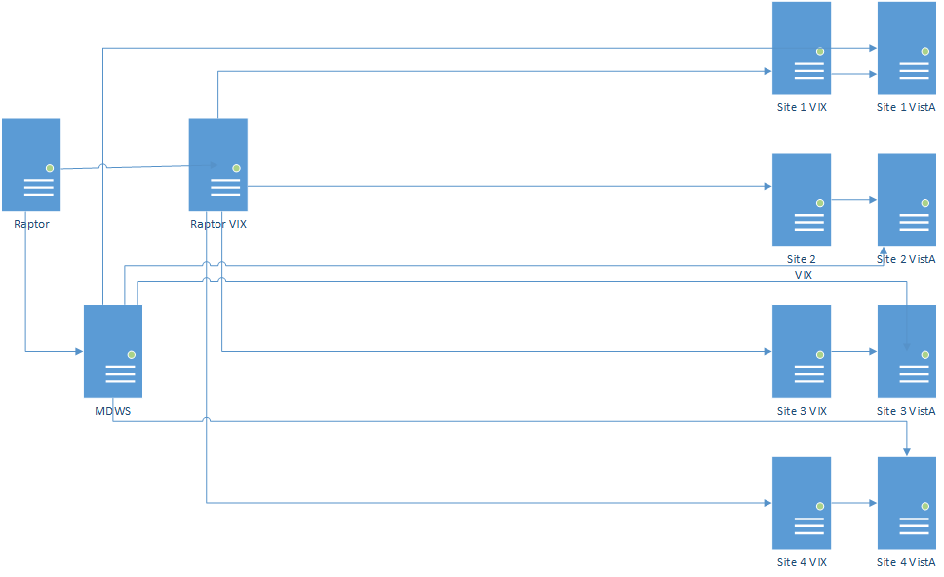
Physical Architecture
Sacramento Data Center
Pilot Sites

Slide 14

Questions

Slide 15
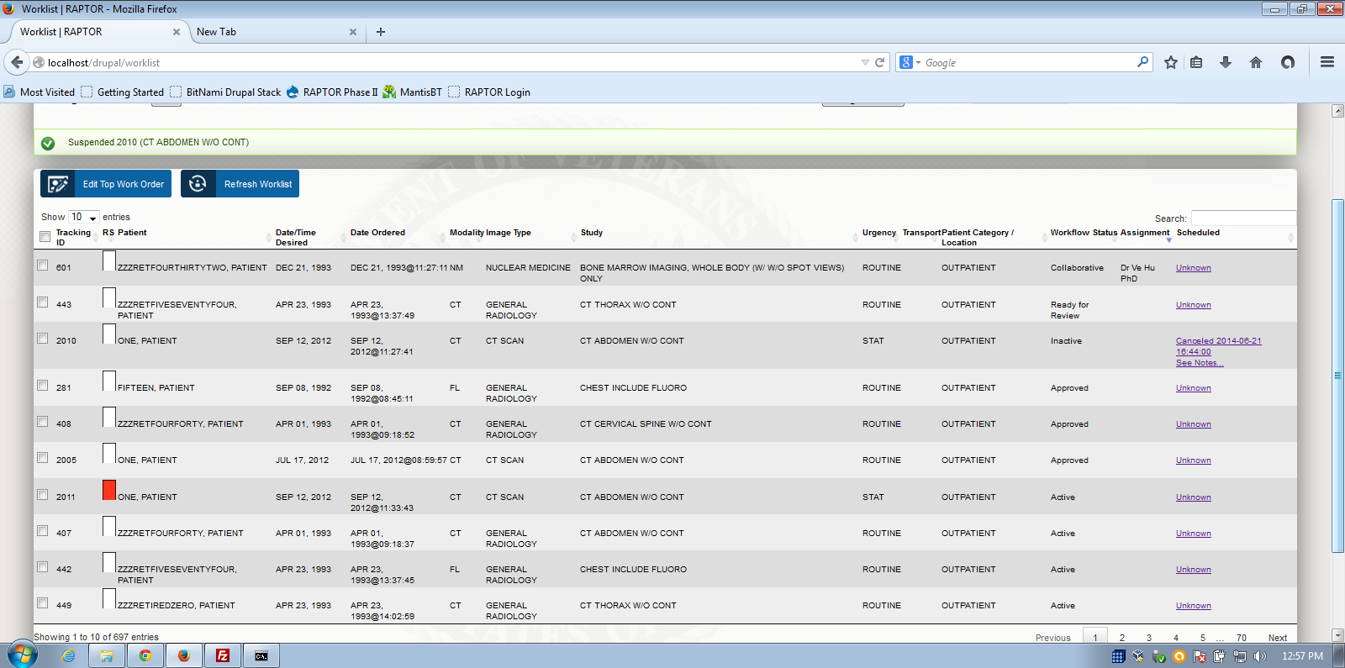
Today’s demo will feature a variety of workflow status
Active, Inactive, Collaborative, Ready for Review, Acknowledged, Approved

Slide 16
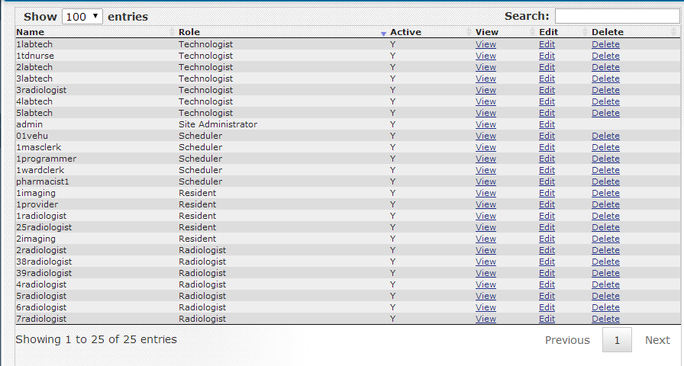
User Management, VistA access

Slide 17
Scheduler Workflow Demo #1
Today’s RAPTOR demo will follow Seattle’s workflow (contact patient, schedule & assign CTs, before protocoling)
Workflow will progress from Scheduler to Resident to Radiologist to Technologist
User access/verify codes are from VistA and validated in RAPTOR
Scheduler assigns CTs but not MR. RAPTOR can handle workflow where protocoling doesn’t begin until scheduling has occurred. Scheduler will logon, review filtered worklist for highest priority CT orders. Scheduler will use RAPTOR to assign and add notes for two different studies to Resident (443 shows descending vitals data and 2005 to show image). Scheduler accidentally double books room and error message is displayed. Patient communications are captured. The Scheduler cancels another exam, based on patient request. Scheduler logs off.
Notes:
Scheduler = 01vehu/vehu01

Slide 18
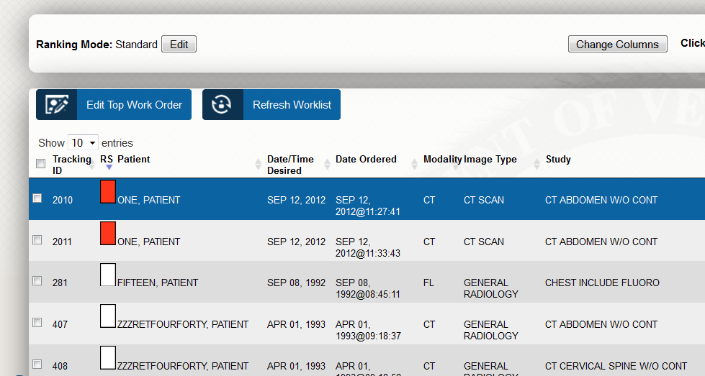
Scheduler, Ranking Score

Slide 19
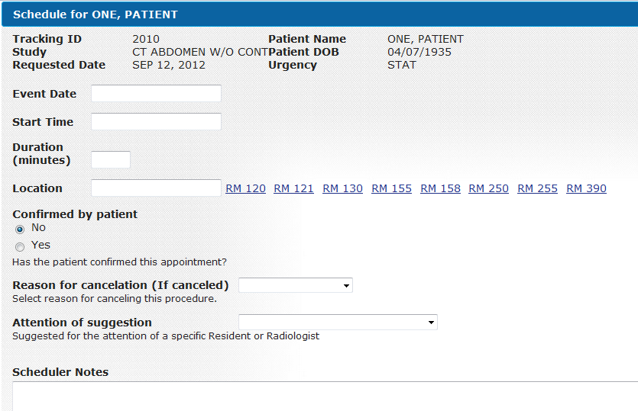
Schedule

Slide 20
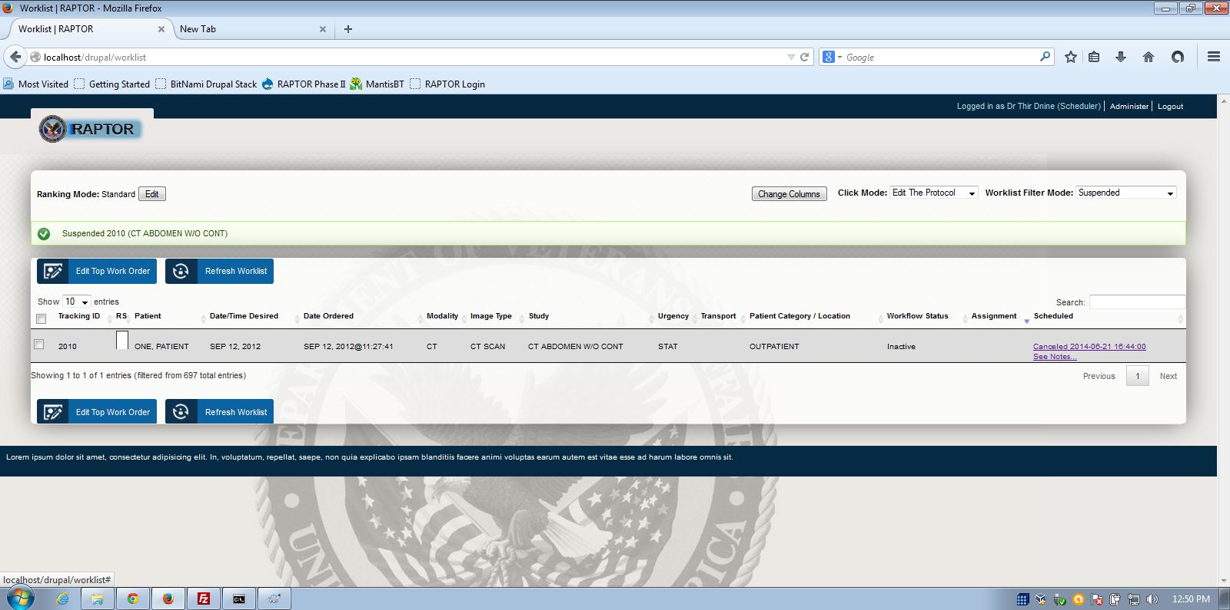
Cancel/Suspended Workflow
Canceled order is recorded. Date, time, notes, patient or VA initiated. Protocol is suspended.

Slide 21
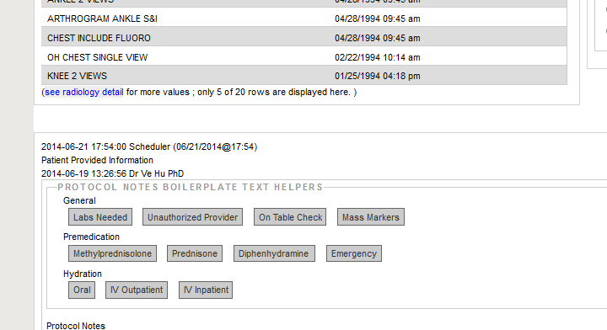
Patient Provided Notes to Radiologist recorded by Scheduler

Slide 22
Resident Workflow Demo #1
Resident will log on and reviews worklist and sees assignment. Resident selects these two for personal list, so one item follows the other. For each, Resident reviews scheduler notes. Two studies assigned are reviewed and protocoled (443 CT Thorax, 2005 CT Abdomen w/o contrast) and prepped for the Radiologist to review and sign. Resident selects request approval. Writes note (using mass marker note) Technologist, please ask patient where mass is and then bracket mass with skin surface markers prior to scanning. Resident logs off.
Notes:
Resident = 1radiologist/radiologist1!

Slide 23
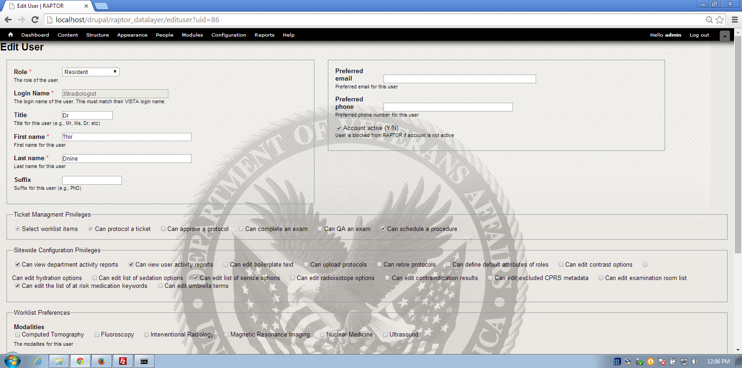
Resident Privileges

Slide 24
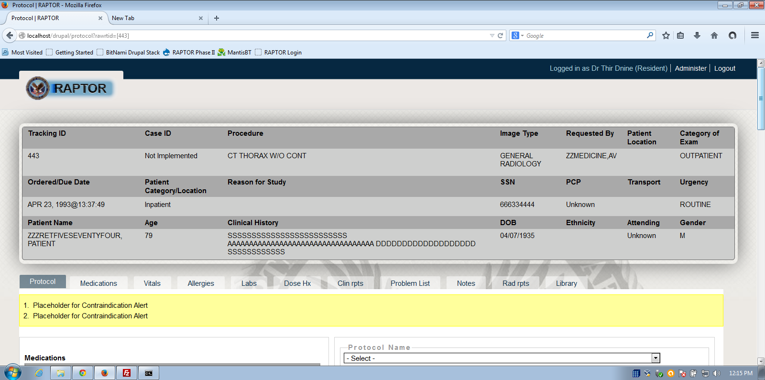
Identified Resident logged into RAPTOR …

Slide 25
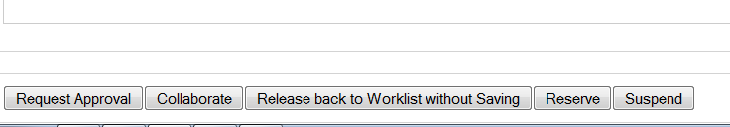
…Resident Privileges in Action
This Resident can Request Approval, Collaborate, Release, Reserve or Suspend …
but cannot approve this protocol.

Slide 26
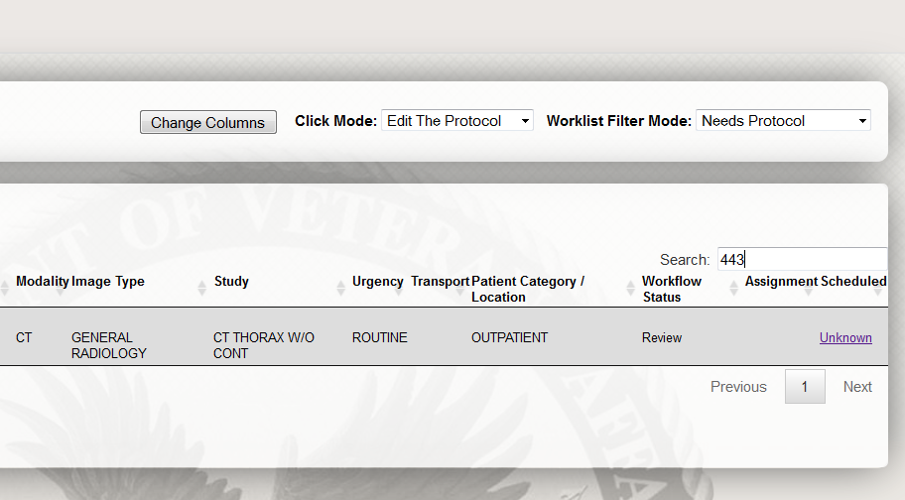
Workflow status = Ready for Review

Slide 27
Workflow Demo for Radiologist and Technologist
Radiologist logs on and reviews worklist and sees collaboration. Radiologist selects these two for personal list, so one item follows the other. For each, Radiologist reviews scheduler notes. Two studies assigned are reviewed and protocoled (443 CT Thorax, 2005 CT Abdomen w/o contrast). Radiologist makes changes and writes note. Radiologist signs and logs off.
Technologist logs on and reviews worklist and sees approved items. Technologist reviews work and acknowledges.
User Management customization and demonstration
Notes:
Radiologist = 2radiologist/radiologist2! Technologist = 3radiologist/radiologist3!

Slide 28
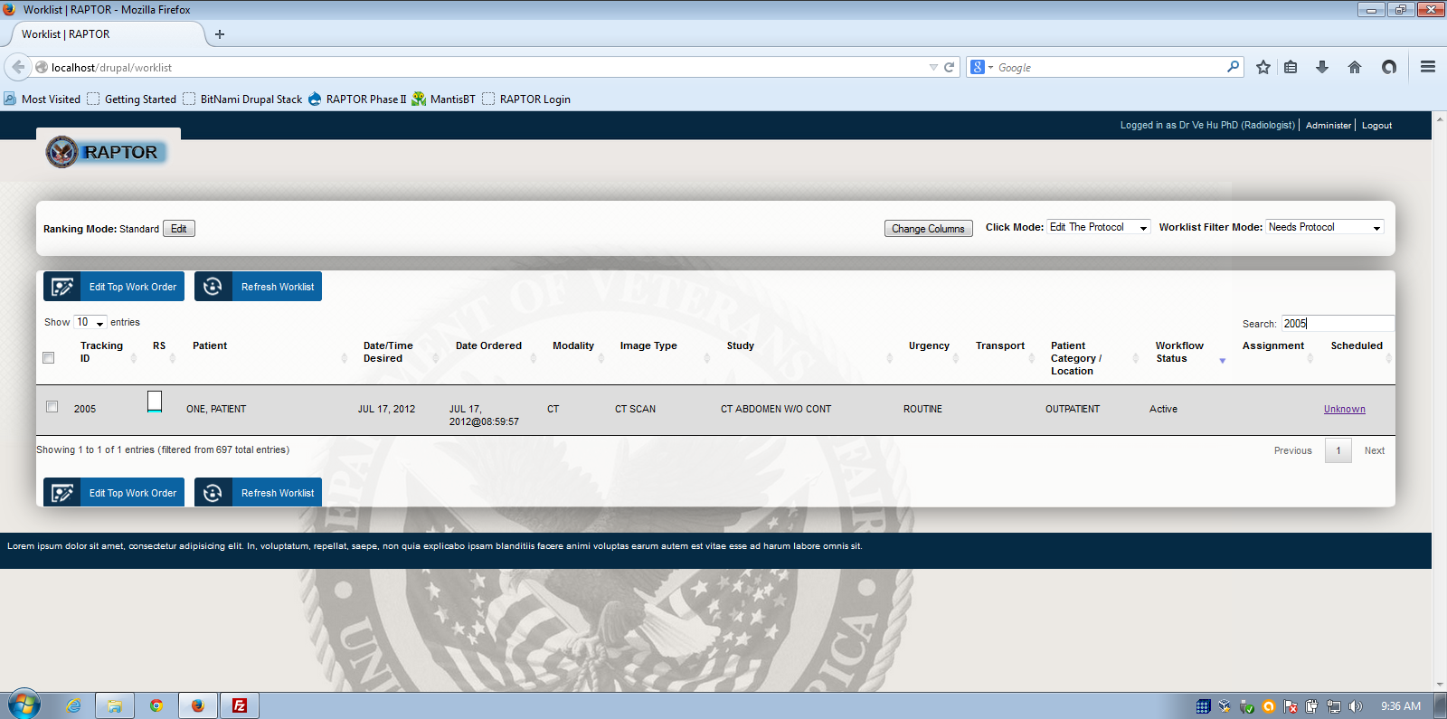
Radiologist searches worklist
The user can search worklist or under tabs for any value.

Slide 29
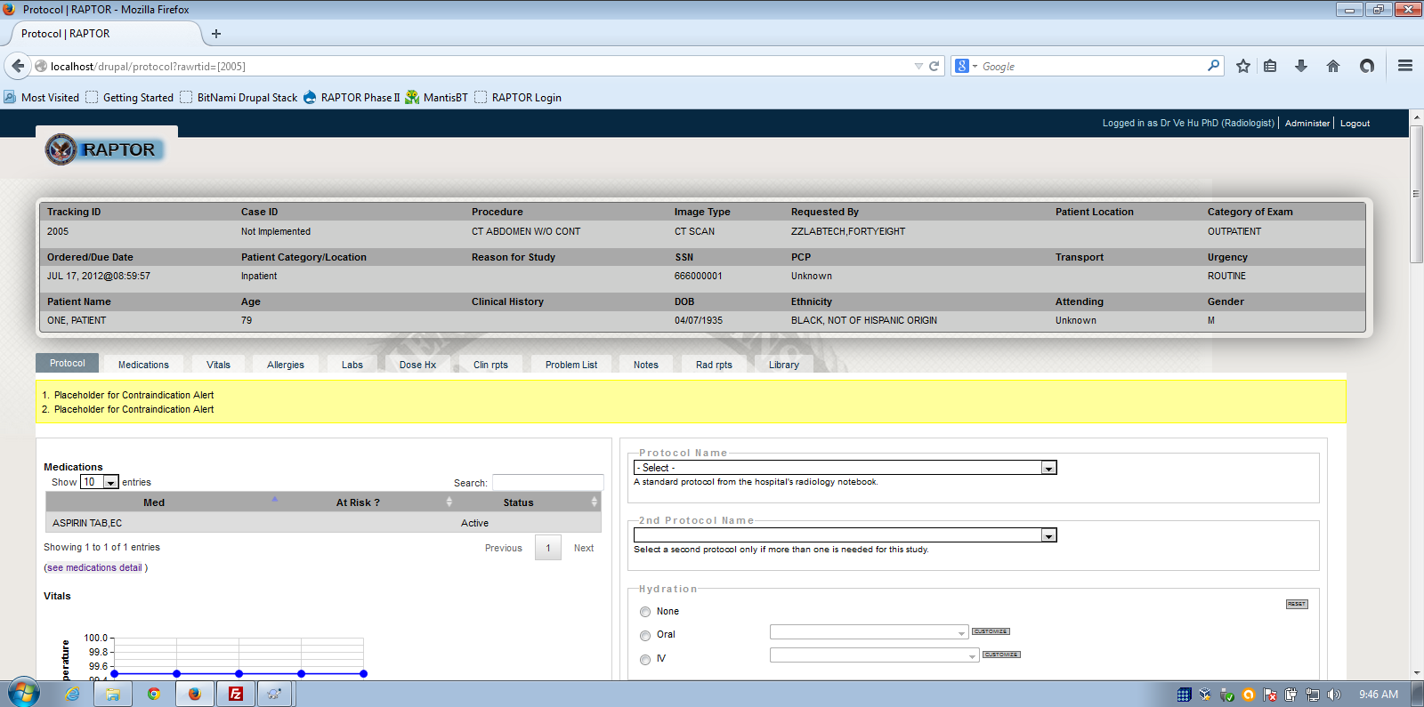
Radiologist selects order and reviews patient history. Selects Rad Reports.

Slide 30
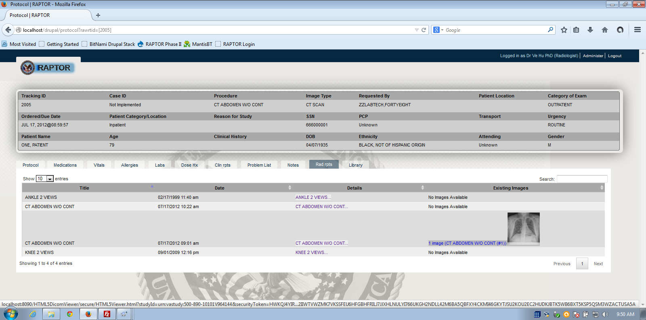
Radiologist Reviews Rad Reports and Images
Images available through VistA Imaging eXchange (VIX)

Slide 31
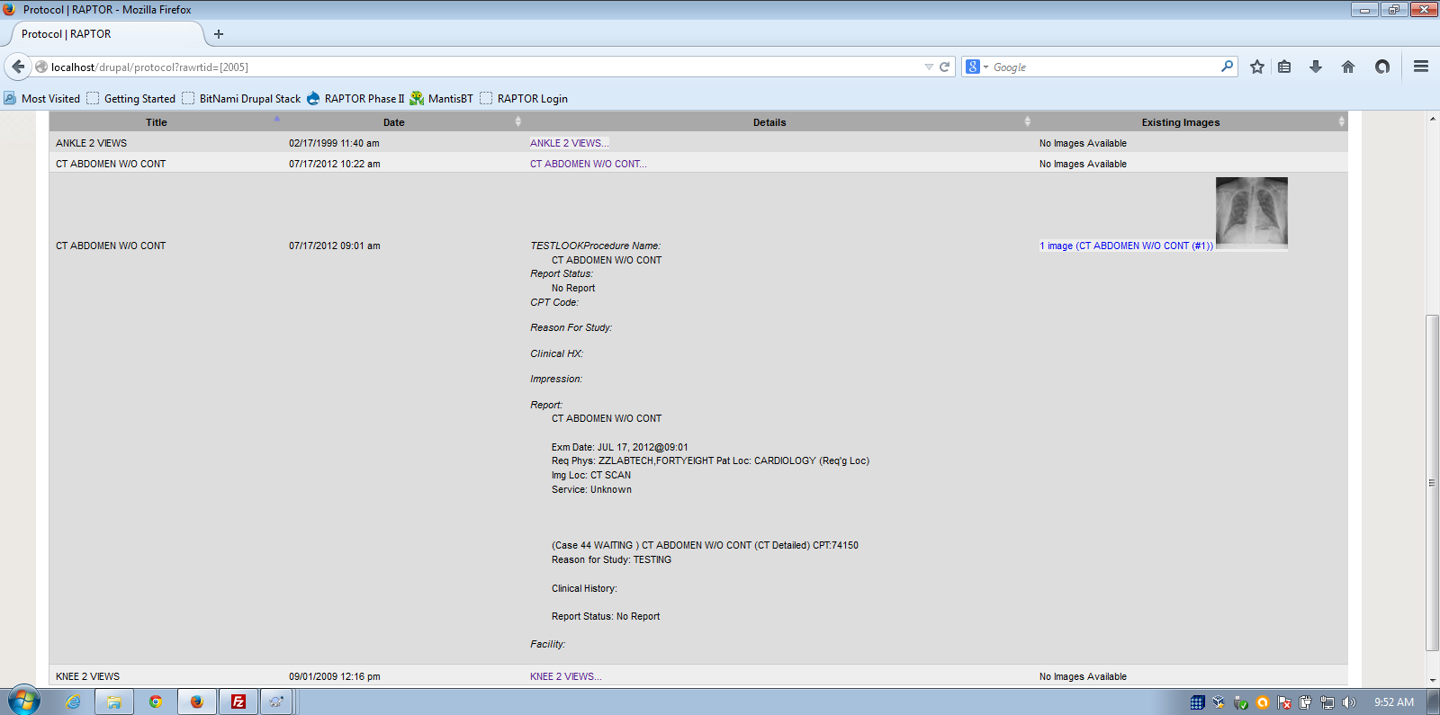
Click to see Report Details (or details under any tab)

Slide 32
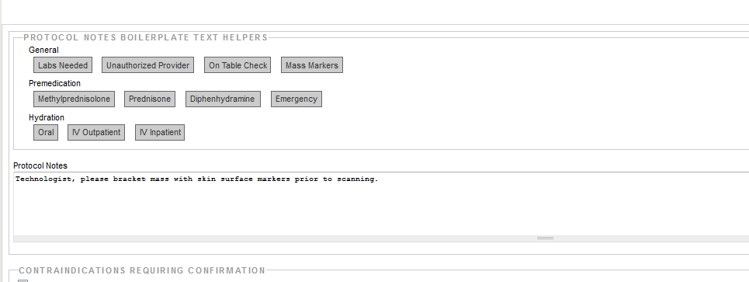
Radiologist uses text helpers to send note to technologist

Slide 33
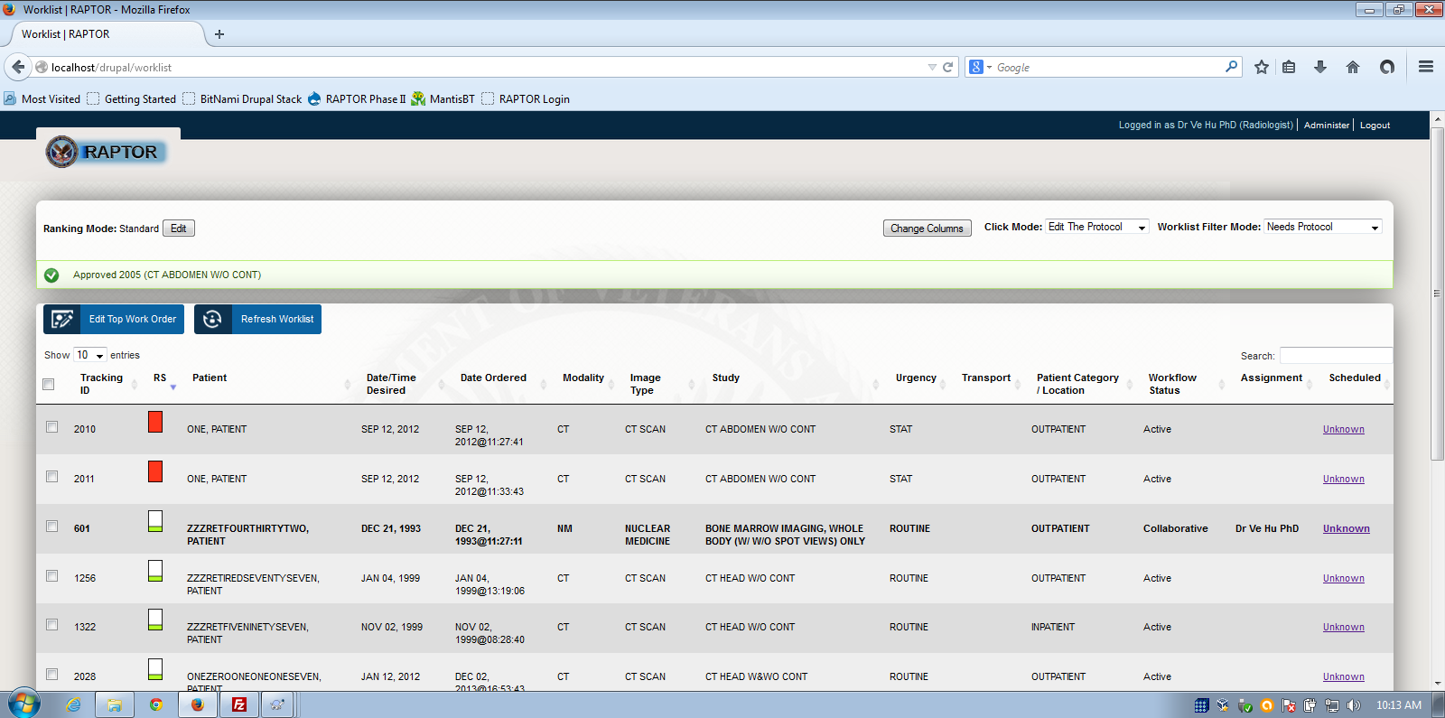
Radiologist Approved Protocol, Order advances to Ready for Examination mode,

Slide 34
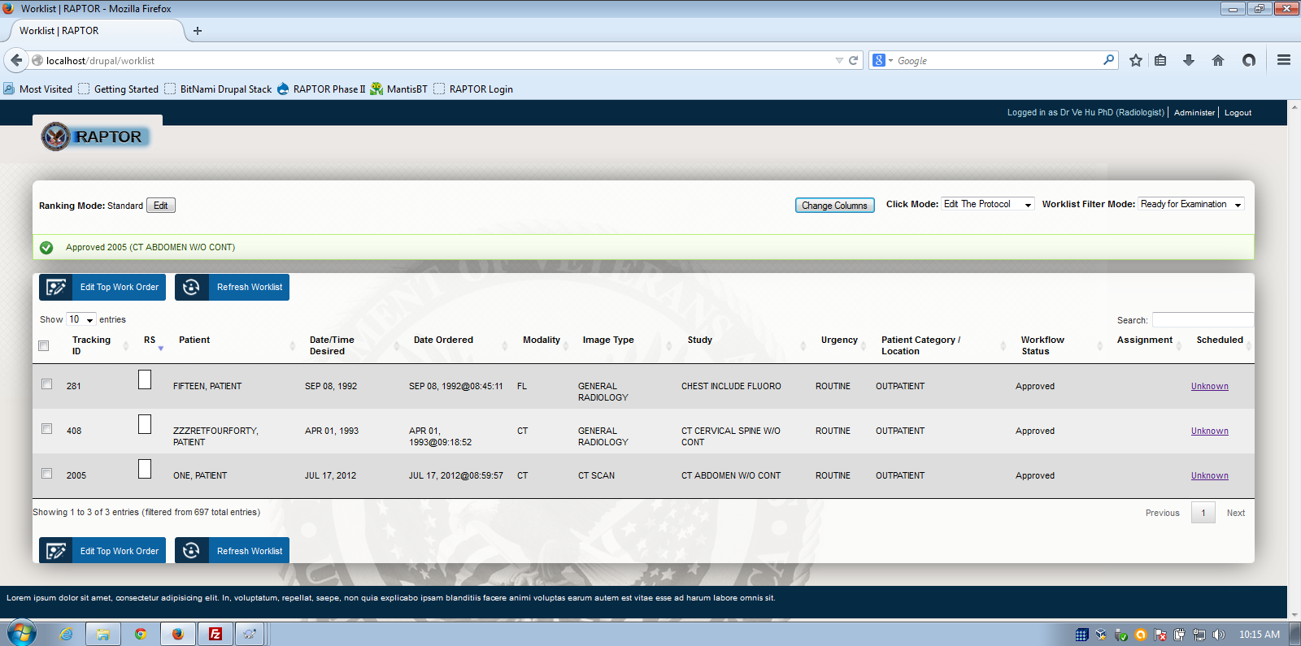
Ready for Examination mode

Slide 35
More info
www.sanbusinessconsultants.com
JDI, Medverd, January 2013
SIIM 2012 Conference: Top 5 Medical Imaging IT Projects of 2012
RSNA 2012
Drupal in Government 2012
OSEHRA 2013

Slide 36
VistA 4 Product Roadmap 2014, 5.6.2 Radiology
Additional new (radiology) capabilities will consist of:
• Ability to assign orders for imaging studies to radiologists so they can be protocoled;
• Select acquisition protocols for ordered and scheduled imaging studies with rationale for selection;
• Communicate imaging instructions to technologists;
• Communicate patient communications from clerk to radiologist and technologist, and;
As listed above, VistA 4 radiology will include best practices functionality such as support for electronic protocols and a dashboard display of the patient’s status, which will facilitate communication between radiologists and technologists. Incorporating protocols within radiology procedures will ensure that important safety information such as allergies and renal functions are clearly communicated.

Slide 37
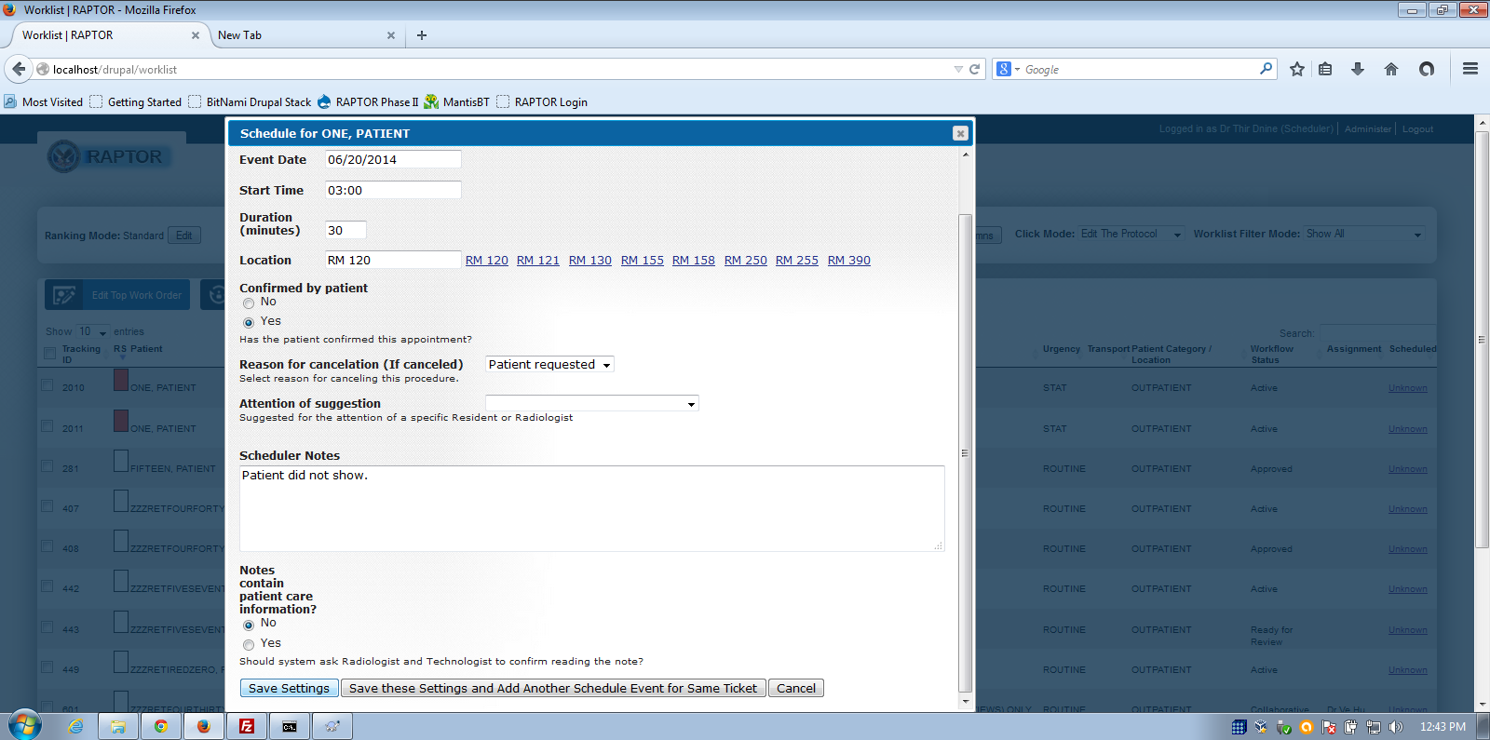
Patient Initiated Cancel

Slide 38
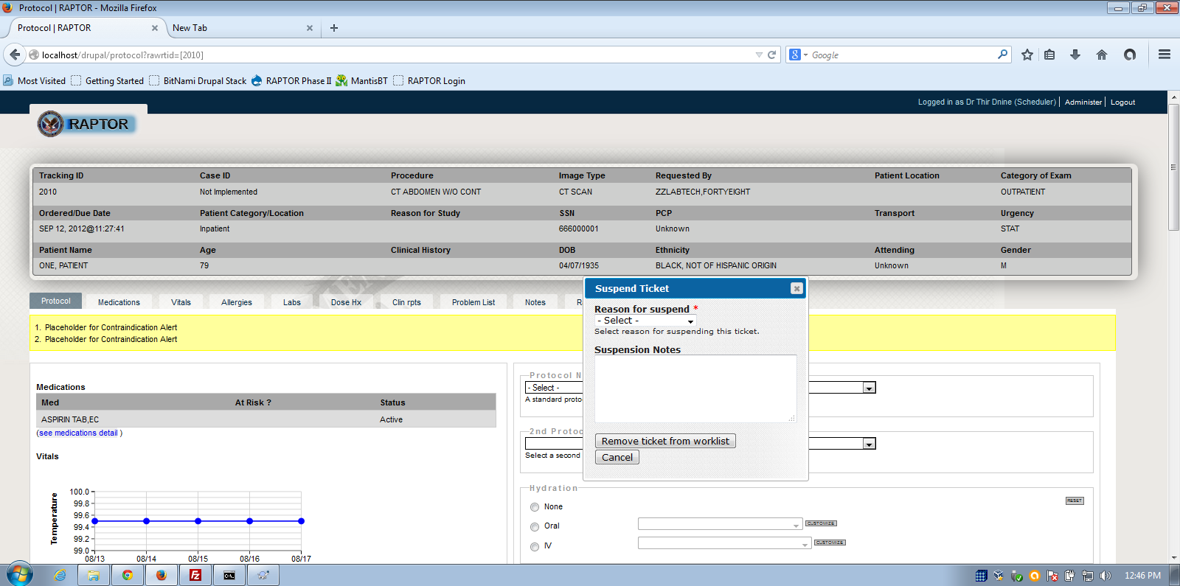
Ticket Suspended

